Slide 1

Desalination Using
Looped Ion Exchange
By Karla Montemayor
Mentor: Dr. Wendell Ela
University of Arizona
Department of Chemical and Environmental Engineering
17 April 2010

Slide 2
Research Objective
Prove that Ion Exchange works as a
pre-treatment to Reverse Osmosis
Show that the Ion Exchange column can be
regenerated
Show that the Regenerant can be recycled

Slide 3
Tucson Water Sources and Demand Projections
500
450
400
Total Demand
Incidental
350
Reuse
300
Supply (1000s of AF)
250
Water Reuse
200
150
CAP Delivery
100
50
Renewable Groundwater
0
1984
1989
1994
1999
2004
2009
2014
2019
2024
Year

Slide 4

The Problem At Hand
  CAP water contains a high concentration of ions
Water Quality
Mean Well
CAP
Constituent
Water
Water
Total Dissolved Solids (mg/L)
179
806
Hardness (mg/L CaCO
3
)
96
322
Sodium
(mg/L)
24
102
Calcium
(mg/L)
31
75
Magnesium
(mg/L)
5
31
Barium
(mg/L)
<
0.01
0.15
Strontium
(mg/L)
<
0.1
1
Chloride
(mg/L)
13
94
Sulfate
(mg/L)
26
256
Alkalinity (mg/L
HCO
3
¯
)
103
119
Total Organic Carbon (mg/L
C
)
< 1
3.1

Slide 5
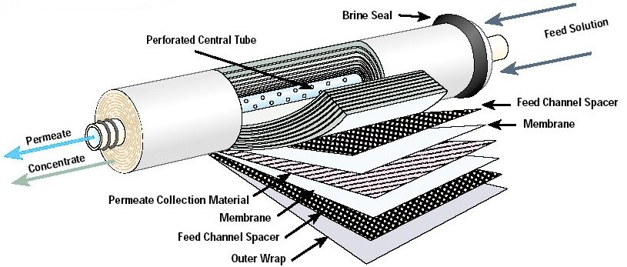
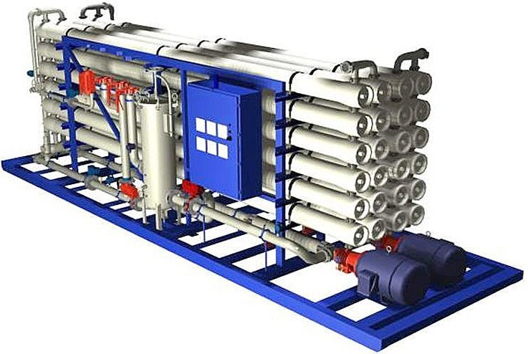
What is Reverse Osmosis?
In Reverse Osmosis, high pressure forces water to pass through porous membranes that filter out particles and ions.
++
SO
++
+
SO
+
Fe
FEED
Fe
FEED
Na
Na
4
4
Concentrated
++
Concentrated
H
++
H
O
O
Mg
FLOW
Mg
FLOW
2
2
Salts
++
Salts
HCO3
++
HCO3
Ca
Ca
H
H
O
H
O
H
O
O
Cl
Cl
2
2
2
2
H
H
O
2
O
2
H
H
H
O
O
H
O
H
H
O
O
O
H
H
H
O
O
O
2
2
2
2
2
2
2
2
2
H
H
H
O
O
H
O
H
H
O
O
O
2
2
2
2
2
2
H
H
H
O
O
2
O
2
2
Permeate
Permeate

Slide 6
Drawbacks to Reverse Osmosis
RO Membrane Fouling
  Scaling due to Barium(Ba) and Calcium(Ca) ions
  Build-up of clay and other organics
Only 85% Water Recovery
  163 Billion Gallons Water Loss/Year
  $165 Million/Year
How Does Ion Exchange Help?
As a pre-treatment to RO, Ion Exchange(IX) can remove most of the ions thereby prolonging the life of the RO membrane and reducing costs and water loss.

Slide 7
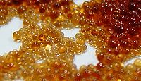
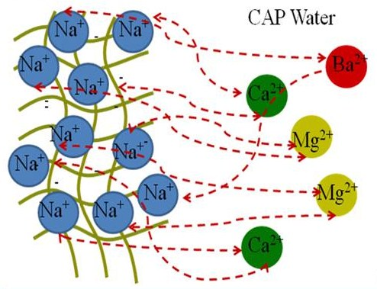
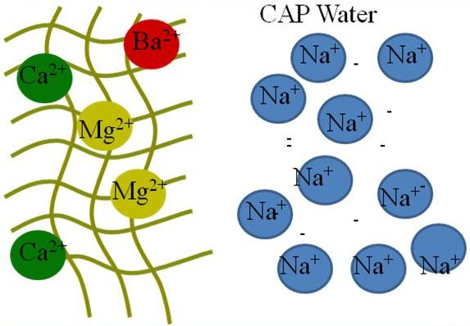
How Ion Exchange Works
Polymer resin beads trap ions in their pores and release them when exchanged for other ions

Slide 8
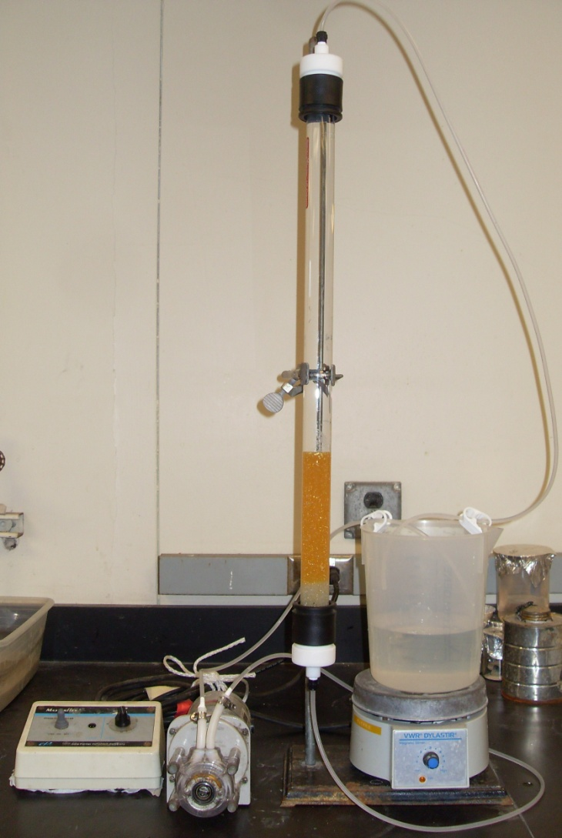
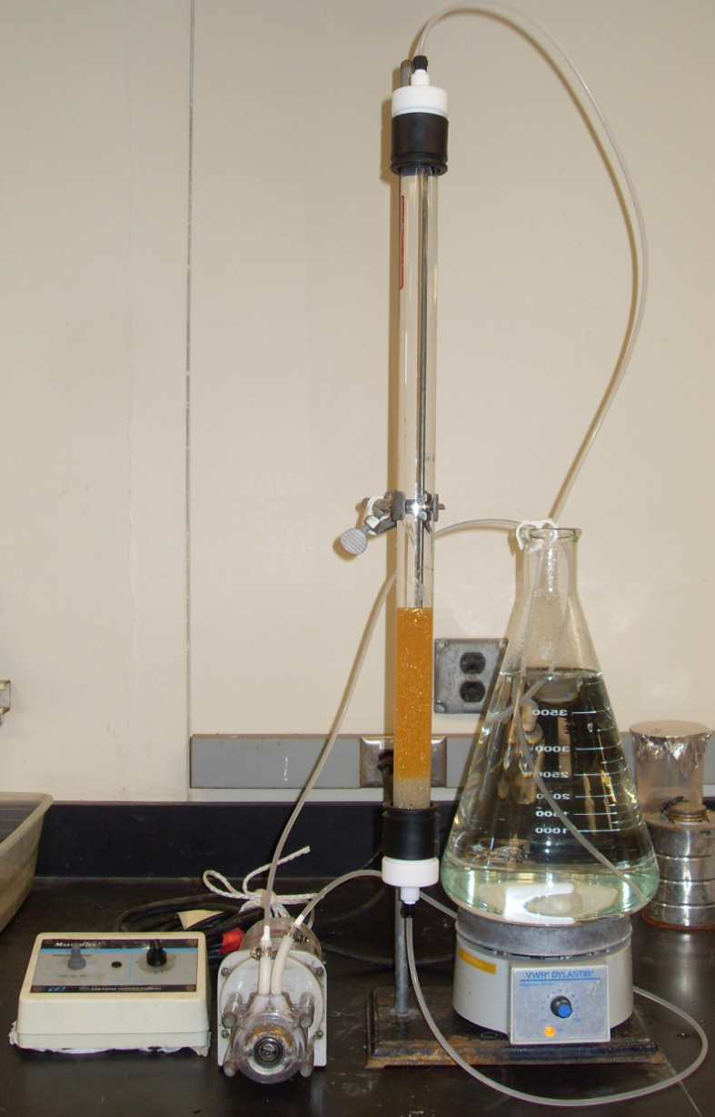
Implemented Model
Experiment only modeled removal of calcium ions
1. CaCl₂ solution loads IX
column with Ca⁺ ions in
exchange for Na⁺ ions
2. Regenerant(brine solution)
loads column with Na⁺ ions
in exchange for Ca⁺ ions

Slide 9
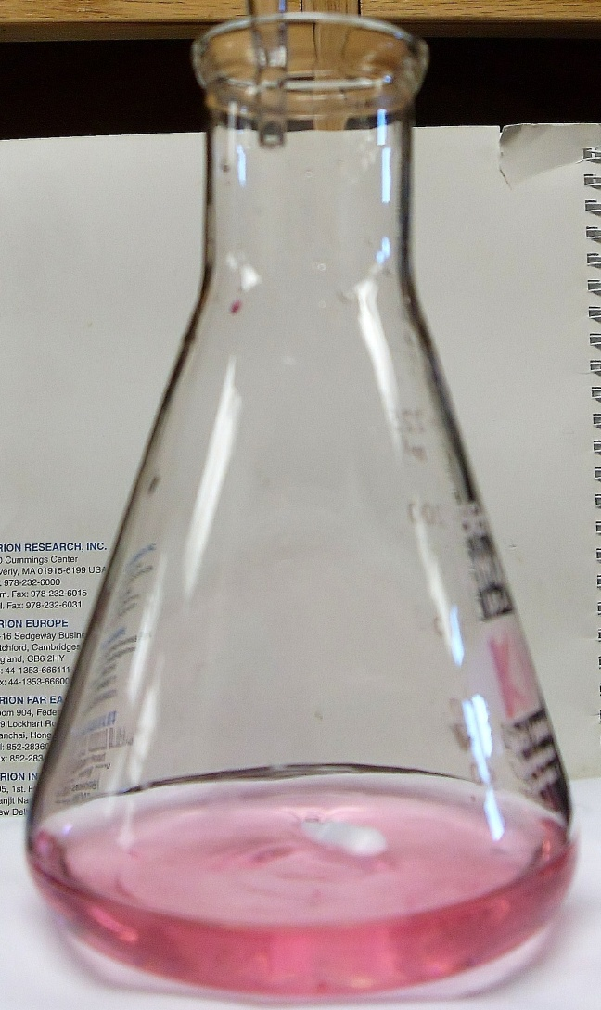
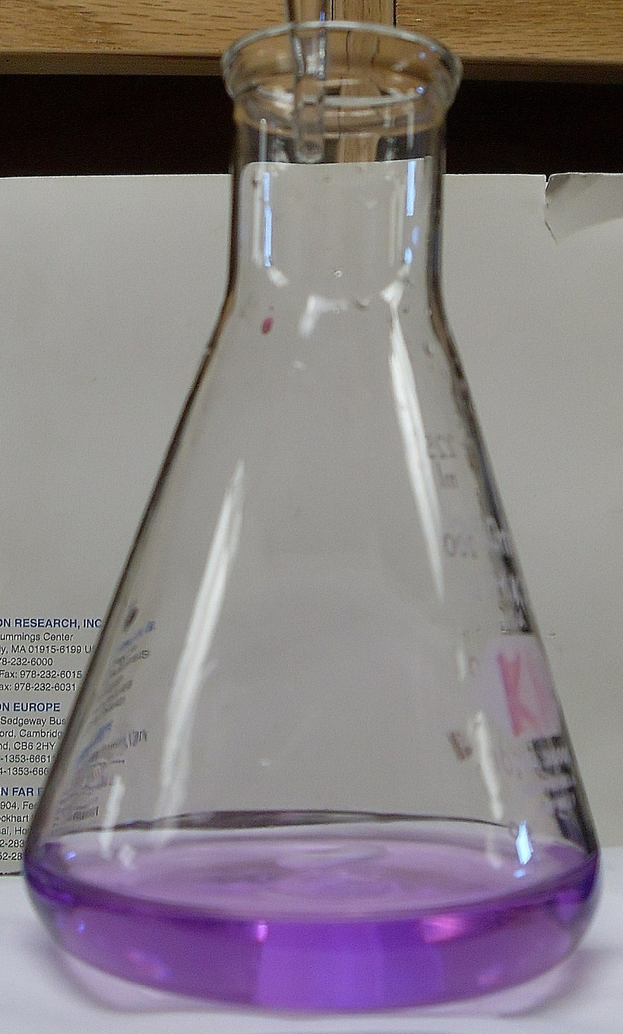

Implemented Model
Before titration with EDTA
After titration with EDTA
Titrate Samples of:
1. CaCl₂ solution before IX
2. CaCl₂ solution after IX
3. Regenerant after IX
Equation to Calculate Mass of Calcium in CaCl₂ solution and Regenerant:

Slide 10
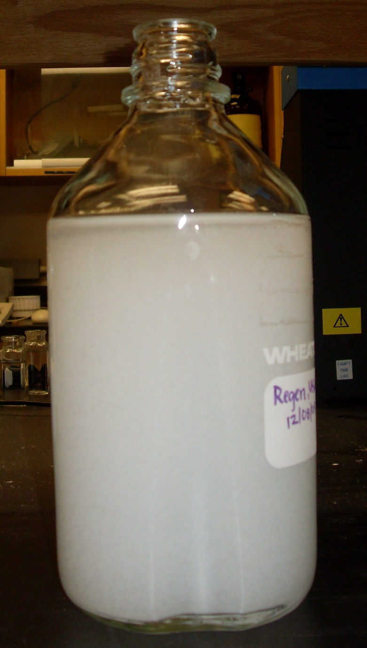
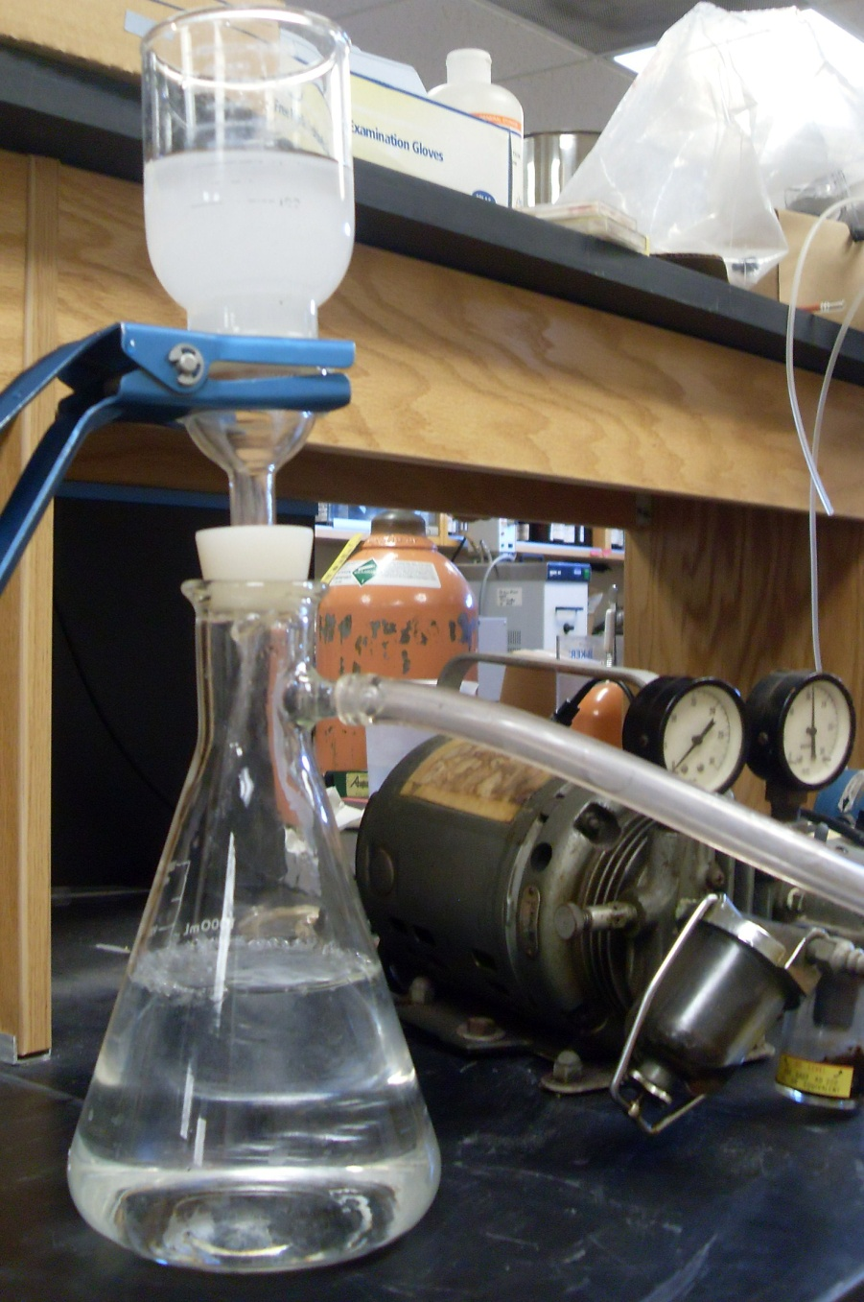
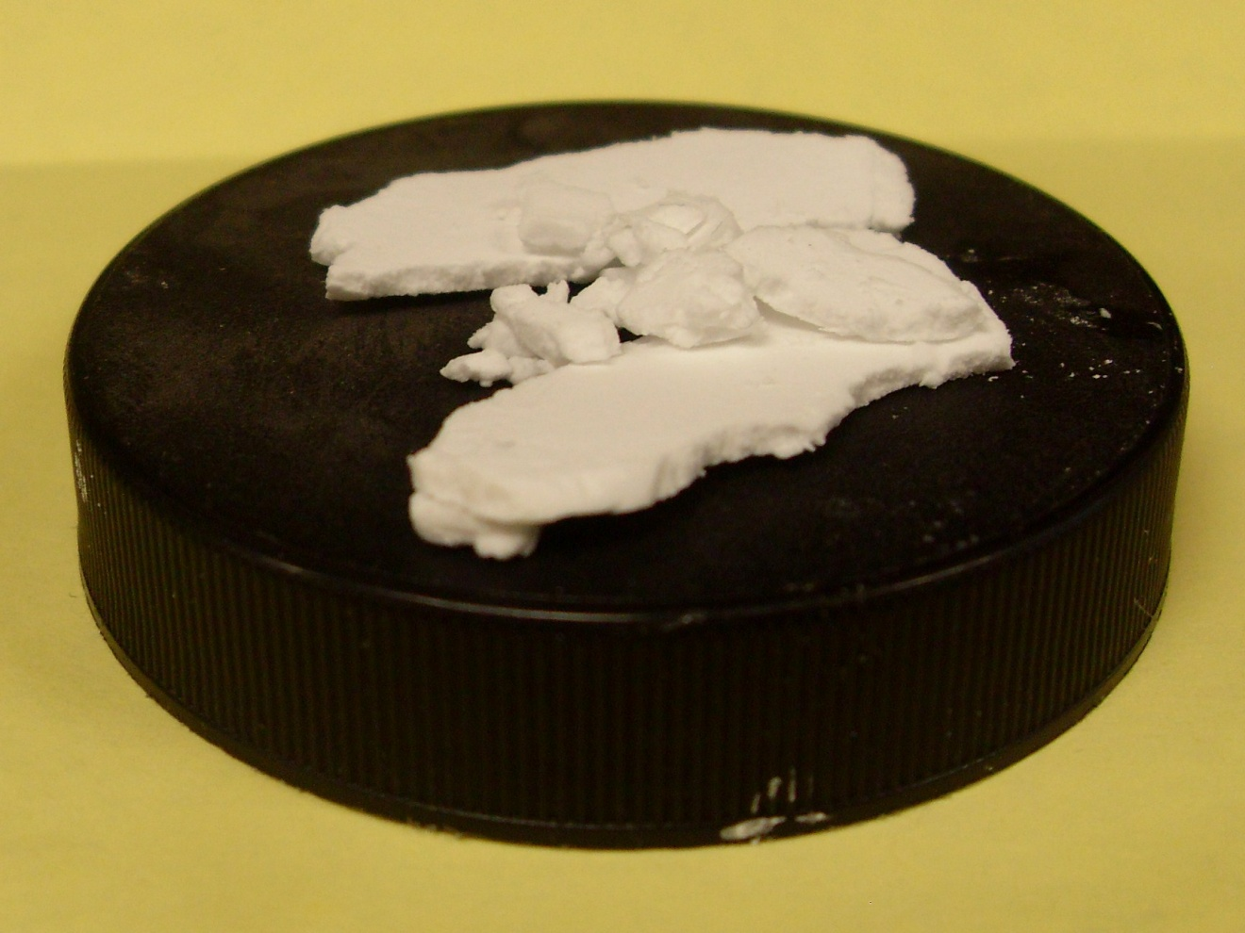
Implemented Model
Softening of Regenerant when IX column falls below 85% capacity
Addition of NaOH and Na₂CO₃ to Regenerant causes precipitation of CaCO₃
Vacuum Filtration of Regenerant removes CaCO₃ precipitate from solution
CaCO₃
Precipitate

Slide 11
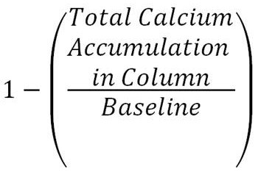
Load Solution: 11g CaCl₂/L, Regenerant: 100g NaCl/L
Baseline = maximum calcium column can
hold
Resin Capacity =

Slide 12
Load Solution: 11g CaCl₂/L, Regenerant: 100g NaCl/L
Resin Capacity =

Slide 13
Load Solution: 11g CaCl₂/L, Regenerant: 400g NaCl/4L
Resin Capacity =

Slide 14
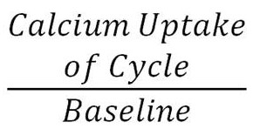
Load Solution: 2g CaCl₂/L, Regenerant: 400g NaCl/4L
Resin Capacity =

Slide 15
Future Goals
Remove other ions such as Barium
and Magnesium
Design and apply model of removing
other ions from Regenerant

Slide 16
Questions?
Acknowledgements:
Special Thanks to Dr. Wendell Ela, Dr. Barron Orr,
Ornella Nkurunziza, and Justin Nixon (U of A)

